Slide 1



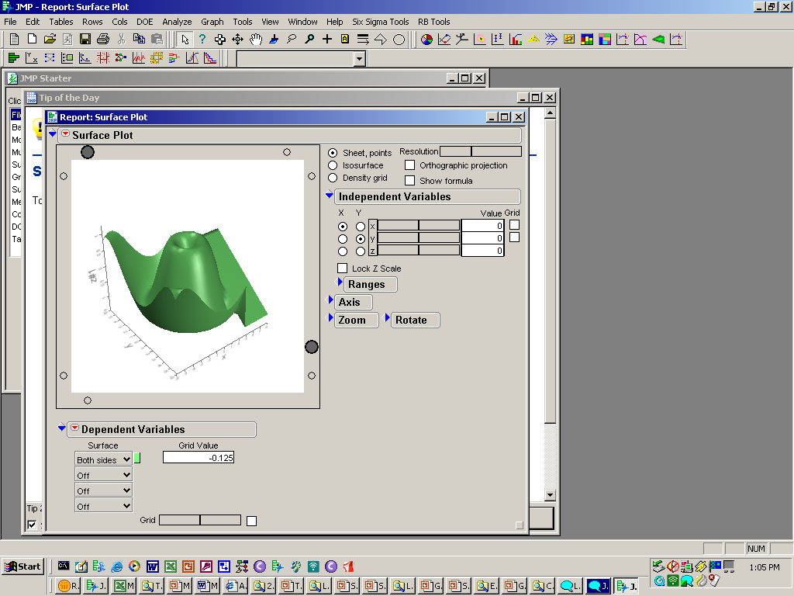
Conducting a Kaizen

Slide 2
Content:
What is a Kaizen?
Why Kaizen?
Stages of Kaizen
  Planning and Preparation
  Event
  Report out
  Follow-up
Appendix
Notes:
ADD NOTES so that the instructor understands the points you are trying to convey (where applicable).

Slide 3
What is Kaizen?
Kaizen
  is a tool to rapidly improve work as part of the PDCA cycle
  is a tool for implementing Rule 4 of the Rules-In-Use
  goals must align with the business objectives
Design (Plan)
Do
1. Customer Needs
Improve (Act)
Feedback (Check)
Meeting Customer Needs:
Internal/External
Shareholders
Employees
Community
Notes:
In order to meet our customer’s needs defined as internal and external, shareholders, employees, and our communities, we must design work (Plan), do the work (do), receive feedback to ensure the desired outcome is achieved (Check), and in our quest for the ideal we improve using feedback (Act). This is the PDCA cycle that Dr Deming spoke of in the 1950’s. Kaizen is one of the methods we use to achieve continuous improvement in a short period of time and is a tool for Rule 4 of the Rules-In-Use.

Slide 4
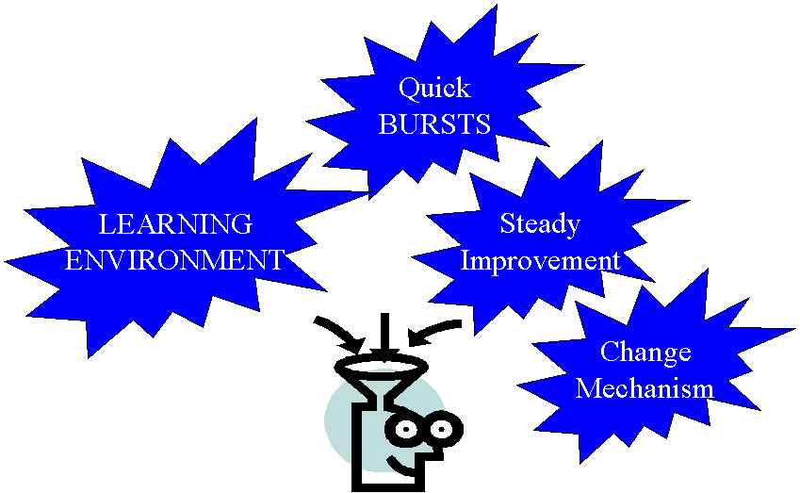
Why Kaizen?
Notes:
Uses for Kaizen are important
So is feeding the individual – make employment desirable/valuable
Identify & Reduce Waste
Reduce Costs
Minimal/No Expense
Employee Involvement
Align actions to customer needs

Slide 5
Content:
What is a Kaizen?
Why Kaizen?
Stages of Kaizen
  Planning and Preparation
  Event
  Report out
  Follow-up
Appendix
Notes:
ADD NOTES so that the instructor understands the points you are trying to convey (where applicable).

Slide 6


Planning and Preparation
There are 5 basic steps:
Identify the business case.
Set goals.
Select the team.
Collect baseline data.
Plan to support the Kaizen activity.

Slide 7

Identify the Business Case
The business case is the launching pad for a kaizen and is defined as a discrepancy between our customer's expectations and our current processes.
The business case creates the focus for the kaizen and is documented on an A3. Examples of a business case for a kaizen include:
  Reduce lead times
  Increase delivery performance
  Eliminate scrap
  Reduce inventories
  Increase capacity
  Eliminate bottlenecks
  Reduce changeover time
  Reduce machine failures
  Quality improvements
Eliminate the Gap!
Customer

Slide 8

Set Goals
  Measurable
    Examples: Time, Money, Defects
  Align with the company’s strategic goals and identified by the Plant A3 and Value Stream Map
    Safety, Quality, Delivery, Cost
  Stretch but realistic (target at least 50% improvement)
  Should result in a new process or new standard
  Documented on the an A3
  1 improvement idea per team member, PER
    OBSERVATION (6-7 ideas per person total)

Slide 9

Select the Team
  Team size should be based on the area(s) being kaizened.
  A trained Facilitator and a Team Leader for each Team
  Typically 4-6 people per machine or process
  Every team member should be chosen for a specific reason
    Management
    “Different Set of Eyes”
    Customers and Suppliers (internal or external)
    Experts (people who actually do the work)
    Maintenance
    Change Agents and “CAVE Men”

Slide 10
Collect Baseline Data
Baseline data is collected to document the current condition and assist in setting the goals. This information may include the following:
Space Constraints Lead Time
Inventory Scrap Rate
Productivity Takt Time
Cycle Time Safety/Ergonomics - Loss
5-S Visual Measurement
Customer Satisfaction (NPS) Current Standard Work
The background information is used to produce a Value-Stream Map or Process Map by the Facilitator or Team Leaders for the problem being addressed by the Kaizen.

Slide 11
Plan to Support Kaizen
While the goal of a Kaizen is to work around the process, interruptions are inevitable as improvements are implemented. Success requires action prior to the Kaizen. Items to consider:
Set maintenance support to cover Kaizen needs
Perform moves that can be identified prior to Kaizen
Set labor to cover customer needs during the Kaizen or work ahead
Adjust work scheduled and flowed through selected area during Kaizen
Create a “claw-back” or “recovery” plan to be instituted after Kaizen if necessary

Slide 12
Content:
What is a Kaizen?
Stages of Kaizen
  Planning and Preparation
  Event
  Report out
  Follow-up
Appendix
Notes:
ADD NOTES so that the instructor understands the points you are trying to convey (where applicable).

Slide 13
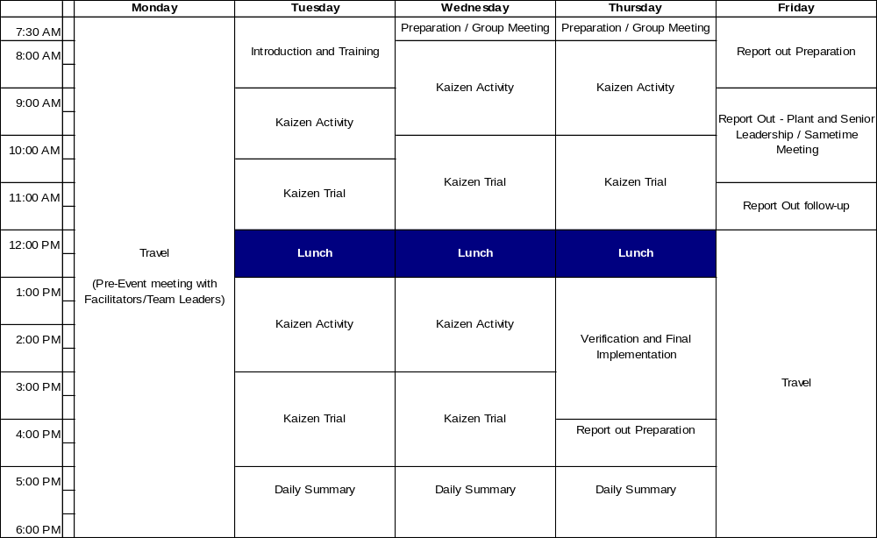
Schedule for the Kaizen

Slide 14

Stages of the Kaizen
The Standard Work elements of a Kaizen are:
Start
Document
Reality
Notes:
Cultural Change – permanent process evaluation/improvement change

Slide 15

Document Reality
Document the Current Process. We need to understand how processes are performed today (may be done prior to Kaizen as well).
Documentation Includes:
Spaghetti Chart
Observation Sheet *
Standard Work Combination Table *
Balance Table
Layout
5S & Safety Audit
Process definition (volume, mix, difficulty levels)
* One for each operator
Take the time to validate the baseline information and understand what is
happening in the area.
Document
Reality

Slide 16

Stages of the Kaizen
The Standard Work elements of a Kaizen are:
Start
Document
Reality
Identify
Waste
Notes:
Cultural Change – permanent process evaluation/improvement change

Slide 17

Identify Waste
Those eight elements that do not increase the value of a product or service, but only increase cost.
Identify
Waste
Attack items that impact
Process Flow
Material Flow
Information Flow

Slide 18

Stages of the Kaizen
The Standard Work elements of a Kaizen are:
Start
Document
Reality
Identify
Waste
Plan
Countermeasures
Notes:
Cultural Change – permanent process evaluation/improvement change

Slide 19
Plan Countermeasures
Focus on the things that can be done within the kaizen
Bias for action vs. planning and analysis
Think within the boundaries of the Lean
process (IDEAL)
  Single-piece flow
  Minimum inventory
  At TAKT time
  Pull production vs. Push production
Low cost solutions, creativity before money
Right-sized resources
Maximum waste elimination
Plan
Countermeasures

Slide 20

Stages of the Kaizen
The Standard Work elements of a Kaizen are:
Start
Document
Reality
Identify
Waste
Plan
Countermeasures
Reality
Check
Notes:
Cultural Change – permanent process evaluation/improvement change

Slide 21

Reality Check
Reality
Check
Problem/Countermeasure Tracking
The Facilitator and Team Leaders review the countermeasures and the to-do list to ensure:
  Proper Direction
  Countermeasures are the proper Lean solutions
If necessary, course corrections are made
The plant Lean Facilitator approves the plan

Slide 22

Stages of the Kaizen
The Standard Work elements of a Kaizen are:
Start
Document
Reality
Identify
Waste
Plan
Countermeasures
Reality
Check
Make Changes
Notes:
Cultural Change – permanent process evaluation/improvement change

Slide 23

Make Changes
Bias for action, Just Do It!!
Use the Kaizen Implementation Report to document the change
Do not dictate how things will be done. Ask team members, build coalition
Hold progress meetings each day: morning, afternoon, or end of day
Keep Kaizen homework updated with the use of the Kaizen Newspaper
Remember: Pre-kaizen planning for possible “moves” may be needed to prepare support services
Make Changes

Slide 24
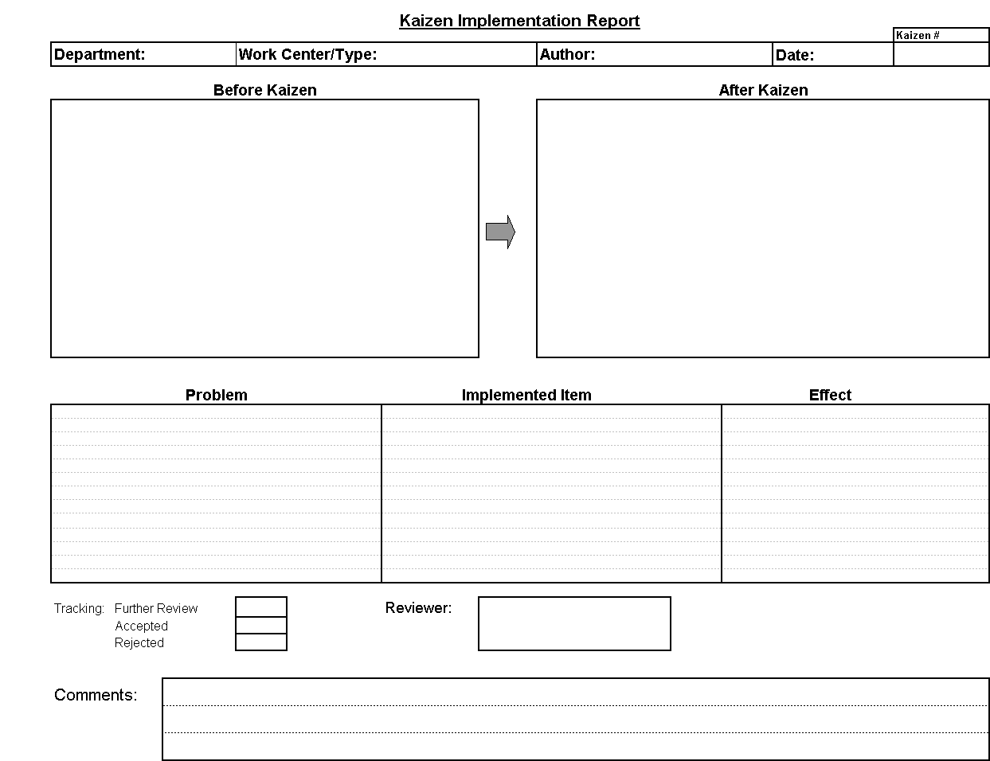

Slide 25

Stages of the Kaizen
The Standard Work elements of a Kaizen are:
Start
Document
Reality
Identify
Waste
Plan
Countermeasures
Reality
Check
Make Changes
Verify Change
Notes:
Cultural Change – permanent process evaluation/improvement change

Slide 26
Verify Change
Verify Change
Observe again
Results Achieved?
If not, go back and make additional changes
Repeat the cycle – observe, implement changes, evaluate

Slide 27

Stages of the Kaizen
The Standard Work elements of a Kaizen are:
Start
Document
Reality
Identify
Waste
Measure
Results
Plan
Countermeasures
Reality
Check
Make Changes
Verify Change
Notes:
Cultural Change – permanent process evaluation/improvement change

Slide 28
Measure Results
Measure
Results
Did waste get eliminated?
Can improvements be sustained?
Are improvements aligned with business objectives?
Is there a possibility of negative unintended consequences?
Were kaizen and individual improvement objectives achieved?

Slide 29

Stages of the Kaizen
The Standard Work elements of a Kaizen are:
Start
Document
Reality
Make this
the Standard
Identify
Waste
Measure
Results
Plan
Countermeasures
Reality
Check
Make Changes
Verify Change
Notes:
Cultural Change – permanent process evaluation/improvement change

Slide 30

Make this the Standard
Establish visual controls (boards, taping, signs, etc.) to ensure progress is maintained.
Make visual controls understandable to the casual observer.
Visibly post open actions (Kaizen Newspaper) and leave posted until completed.
Lean Facilitator to help establish control and counsel on the kaizen closure.
Results must be repeatable and sustainable.
Make this the standard

Slide 31


Celebration
Celebration
Celebrate the success (but not too long) because now you
Do It
Again

Slide 32

Stages of the Kaizen
The Standard Work elements of a Kaizen are:
Do It
Again
Start
Document
Reality
Celebrate
Make this
the Standard
Identify
Waste
Results:
A new way of work
Measure
Results
Plan
Countermeasures
Reality
Check
Make Changes
Verify Change
Notes:
Cultural Change – permanent process evaluation/improvement change

Slide 33
Content:
What is a Kaizen?
Stages of Kaizen
  Planning and Preparation
  Event
  Report out
  Follow-up
Appendix
Notes:
ADD NOTES so that the instructor understands the points you are trying to convey (where applicable).

Slide 34
Report Out Content
Title page
Team Participants with Photo
A3, Value Stream Map, or Progress Control Board information to ensure alignment with business objectives.
Goals of Kaizen
Information or Examples showing Lean tool usage that may include:
    Before / After Photos
    Kaizen Implementation Reports
    Spaghetti Diagrams
    Control Charts
Homework (Kaizen Newspaper)
Lessons Learned
Summary
Sample slides from previous report outs are in the appendix

Slide 35
Content:
What is a Kaizen?
Stages of Kaizen
  Planning and Preparation
  Event
  Report out
  Follow-up
Appendix
Notes:
ADD NOTES so that the instructor understands the points you are trying to convey (where applicable).

Slide 36
Follow-up
After the kaizen, the focus must be placed on ensuring that the improvements continue.
This is done by:
Reflection with the participants to determine where the kaizen needs improvement.
Aggressive follow-up on open Kaizen Newspaper action items by Black Belt and plant management
  Establish post-kaizen ownership team, include on the Kaizen Newspaper, and leave in place until open items are closed.
Development of an “Information Control Center,” providing a visual and immediate observation of continuous improvement
Random reviews by plant management. GEMBA
  Floor walkthroughs
  Plant assessments

Slide 37
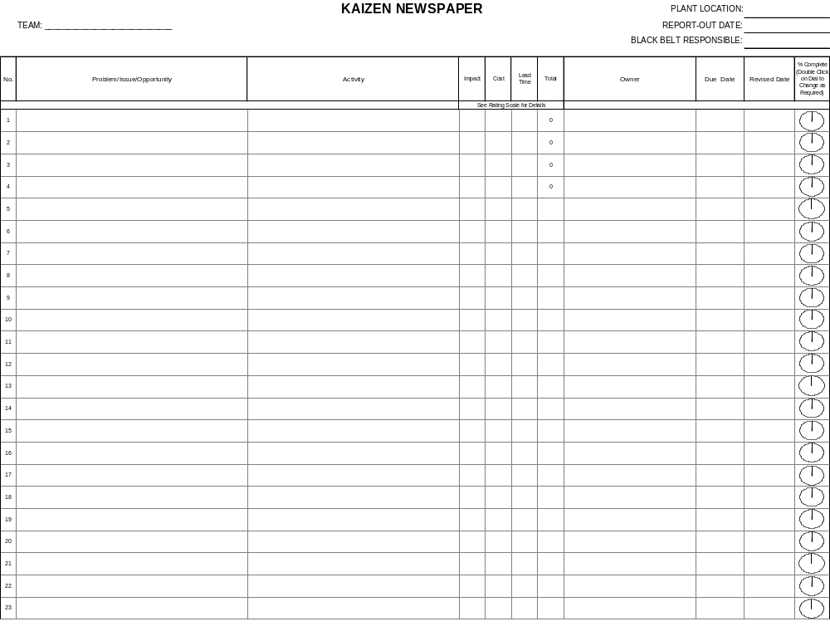
Kaizen Newspaper Form

Slide 38
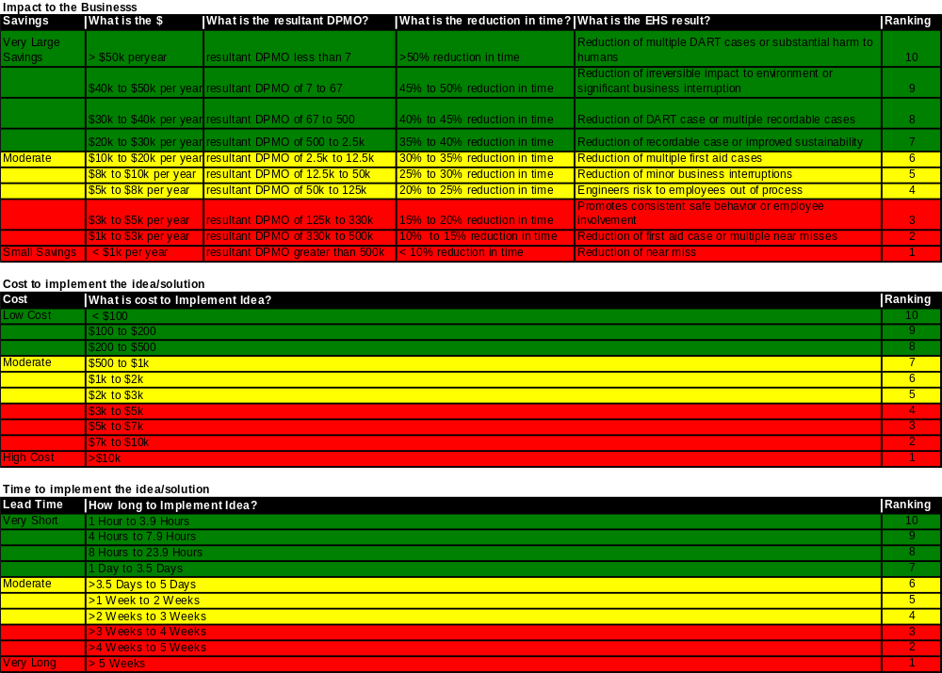
Kaizen Newspaper Rating Scale
Notes:
25

Slide 39
Kaizen Newspaper Guidelines
RATING SCALE:
  Multiply Impact x Cost x Lead Time to obtain Total
  Sort numbers by highest to lowest. This will prioritize the top items to work on and also show the ‘cliff’ vs ‘rubble’
NOTES:
  Newspaper should be posted in visible location for all to see (ie: on the floor, or in the office – at GEMBA)
  The Kaizen Newspaper will be a requirement for the Report-Out and will need to be included in the
  PowerPoint presentation
  Items on the list should be completed within 60 days.
  Items with leadtime longer than 60 days should be listed on a separate Plant Master Newspaper (use same form) and reviewed monthly by Plant Management and Lean Leadership to see if they have a high enough priority number to validate working on or if newer projects should take precedence. Projects on Plant Master Newspaper could be used for future projects or continuous improvement activities.

Slide 40
Review
Identify what is a Kaizen
  Burst of teamwork to improve a process or correct a problem preventing the business from achieving its goal.
Stages of a Kaizen
  Planning and Preparation
  Event
  Report Out
  Follow-up

Slide 41

Any Questions?

Slide 42
Content:
What is a Kaizen?
Stages of Kaizen
  Planning and Preparation
  Event
  Report out
  Follow-up
Appendix
  Sample presentations
  More detailed information
Notes:
ADD NOTES so that the instructor understands the points you are trying to convey (where applicable).

Slide 43

Title

Slide 44
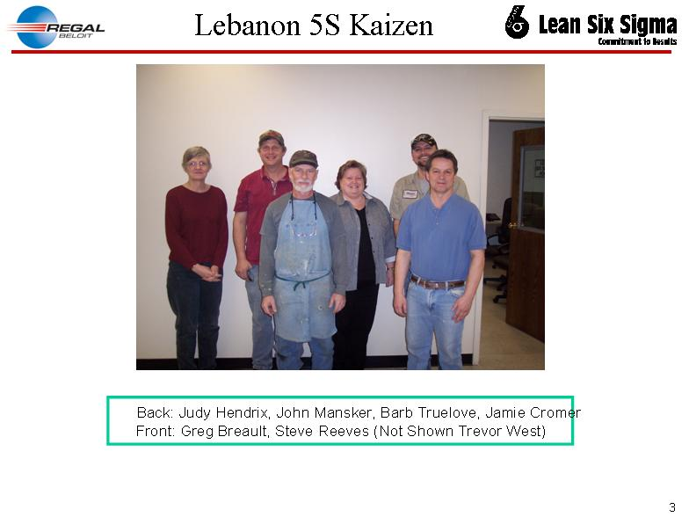
Participants (Names and Photo)

Slide 45
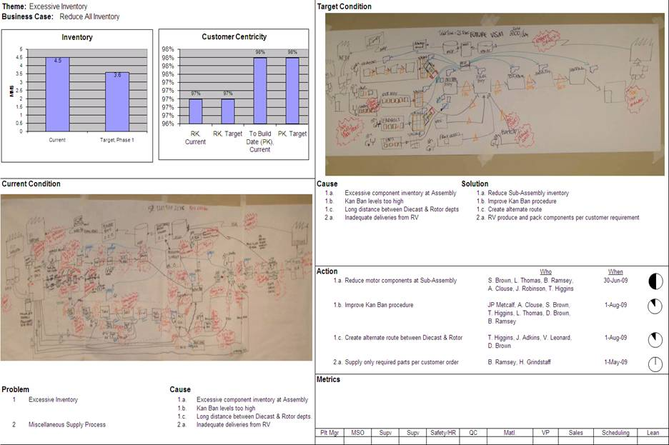
A3 and VSM (Alignment with Business)

Slide 46
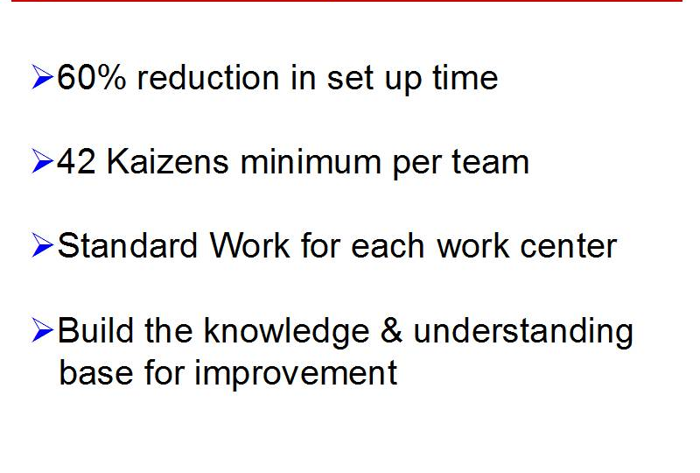
Goals of Kaizen

Slide 47
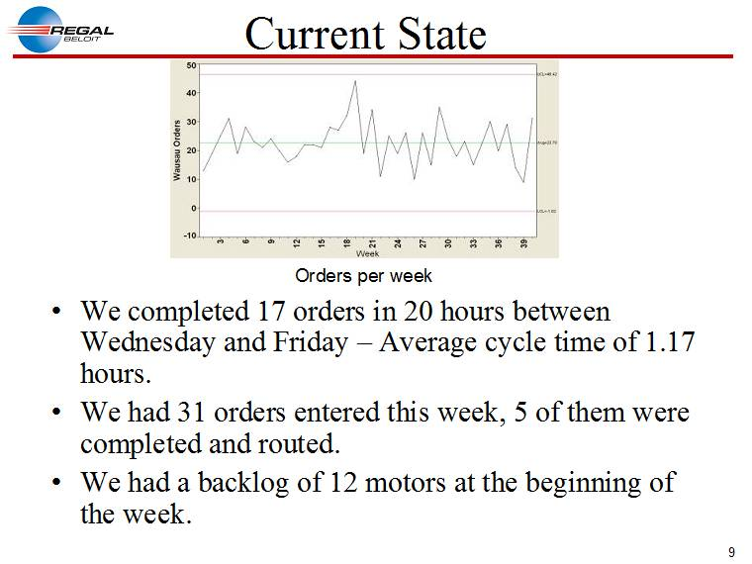
LSS Tool Example

Slide 48
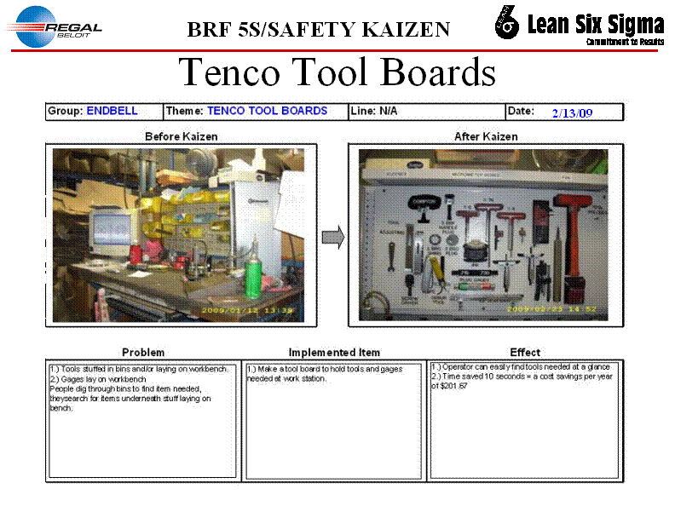
LSS Tool Example

Slide 49
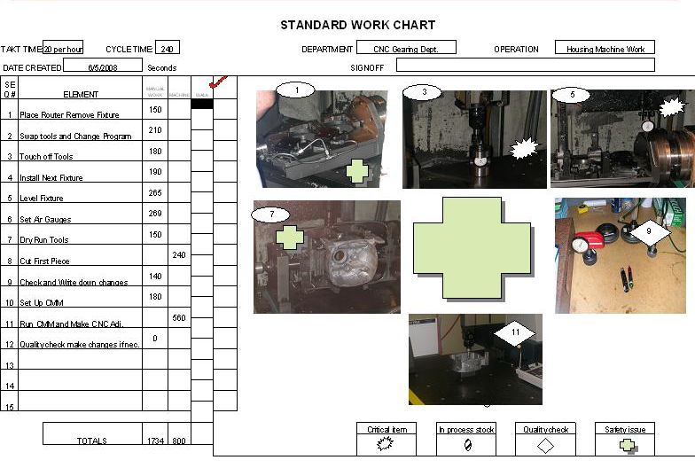
LSS Tool Example

Slide 50
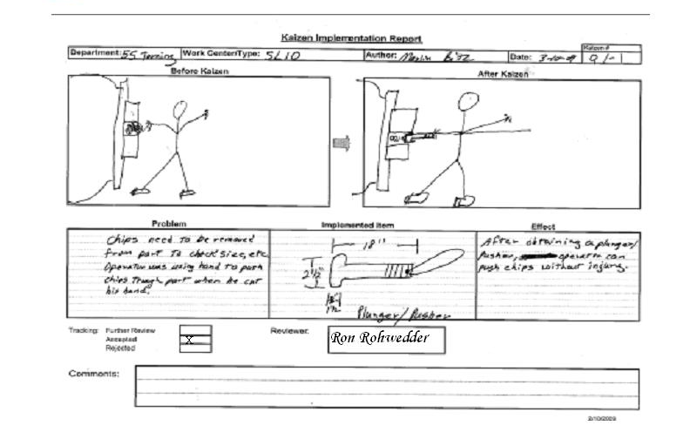
LSS Tool Example

Slide 51
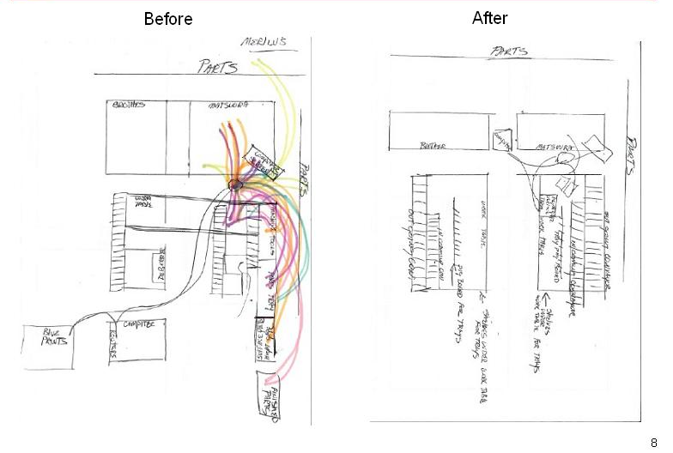
LSS Tool Example

Slide 52
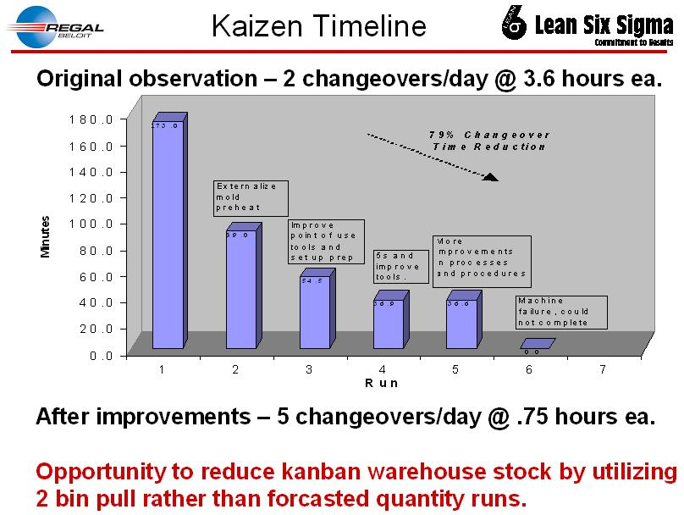
LSS Tool Example

Slide 53
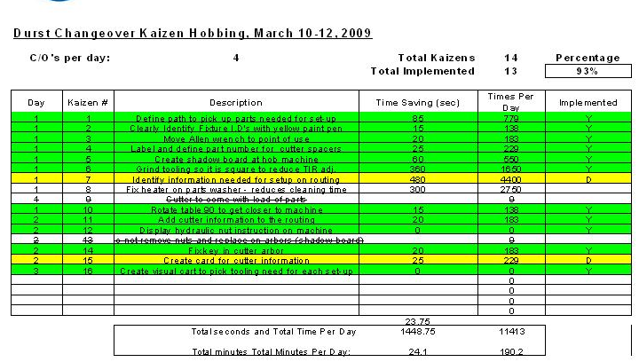
Homework and Achievements

Slide 54
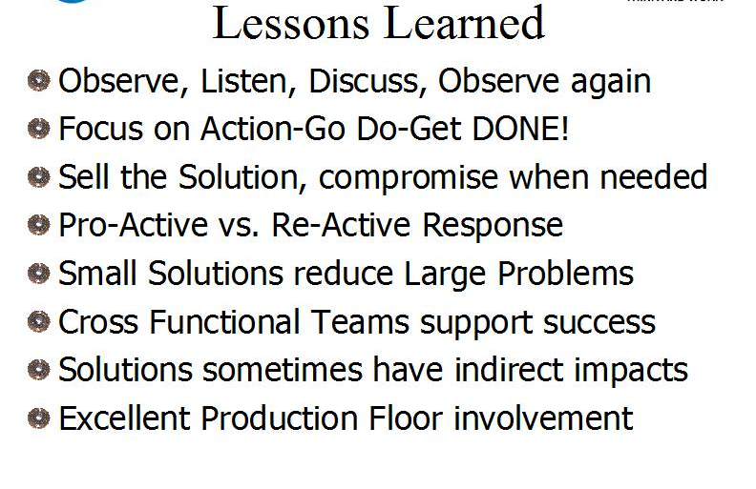
Lessons Learned

Slide 55
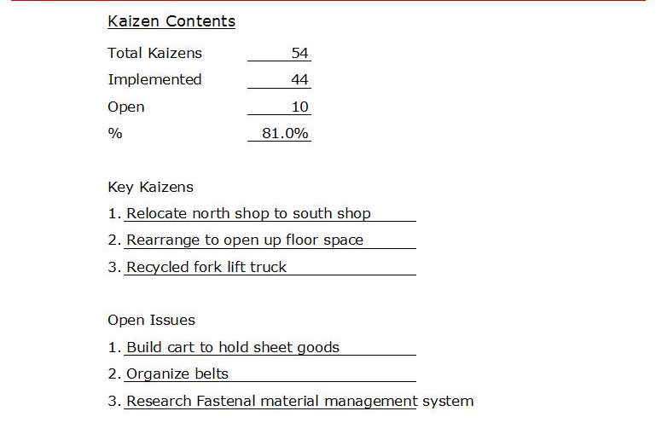
Summary

Slide 56
Summary
Kaizens
Total Kaizens ______
Implemented ______
Open ______
% _____%
Impact
______
______
______
Key Kaizens
1.
2.
3
Impact
______
______
______
Open Issues
1.
2.
3
Impact
______
______
______

Slide 57
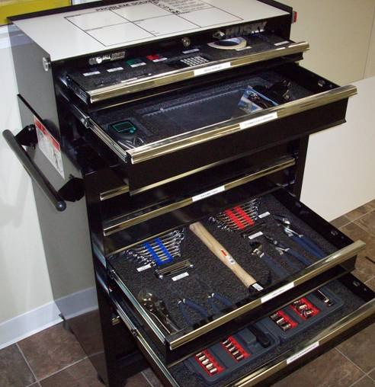
Kaizen Kit
6 highlighters of various colors
1 white eraser
3 black markers
3 red markers
3 red pens
3 stopwatches
1 box binder clips or paper clips
5S Red Tag kit
6 clipboards
Zip-ties
3 sets earplugs
60 magnets or magnetic pipe plugs (3 sets of 20)
12 mechanical pencils
3 grease pencils
3 calculators
3 tubes .05mm lead refills
1 small stapler
1 box staples
1 staple puller
1 Scotch Tape disposable dispenser
1 pair scissors
3 sets dry erase markers (5 colors minimum, chisel tip)
1 roll masking tape
1 multi-tool (or screwdriver with multiple tips)
1 18” ruler
18 Post-It Pads (6 each of 3 different colors) 2 7/8 x 2 7/8
Rubber bands
Other items to have on-hand:
VCR and TV
Speakerphone
Laptop for Sametime Presentation
Each Sub-Team should have:
One Flipchart
One Camera
One Video Camera

Slide 58
Kaizen Facilitator
The Facilitator has prior experience as a team member and Team Leader. That experience may be gained through either internal or external Kaizen participation. When assuming the role of Facilitator, he or she must complete at least two kaizens.
The Facilitator is responsible for:
Ensuring that the kaizen goals have been agreed-to by plant Senior Management and support Regal Beloit’s goals
Confirming that the area is confined to a specific area or product
Establishing measurable goals
Coordinating with the leadership of other departments when the product passes through their area
Creating high level process maps to help define the objectives, scope and time limits
Developing opening meeting with local management
Scheduling the team, break out areas, and presentation rooms
Informing the plant and shop floor as far in advance as possible
Working with the plant Senior Management to ensure Cost, Quality, Productivity, Safety and Morale issues in the area are addressed

Slide 59
The Facilitator should:
Prepare and give training
Inform the Team Leaders of what is needed and support them in answering questions on the team’s progress
Coordinate all logistics requirements
Provide specific training as needed through Team observation
Monitor team performance to daily goals
Coach and motivate teams as needed
Assist in developing the report-out

Slide 60


Team Leaders
It is beneficial (but not necessary) that the Team Leader has prior experience as team member. That experience may be gained through either internal or external Kaizen participation. The Team Leader should be a formal or informal leader in the Kaizen area of focus.
Each team is led by a Team Leader. The leader should:
Have proven leadership/communication/people skills
Be experienced in the kaizen process if possible
Be able to relate to direct labor as well as senior management
Not be intimidated by senior management (senior management may be team members)
Be a stickler for detail, show initiative, and be tenacious in completing tasks, correctly and on time
Also empower, coach and facilitate the team in determining what and how things will be done; not dictating the what and how

Slide 61

The Team Leader should:
Pick up Kaizen Kit
Review baseline with team and give daily assignments
Participate in all steps of the Kaizen process
Coordinate equipment moves w/maintenance and Facilitator
Prepare daily presentation and assignments for final presentations
Return Kaizen Kit
Prepare and participate in the follow-up plan.

Slide 62

Team Members
Team composition is critical to success. Everyone must be chosen for a purpose and should reflect the following:
“A Different Set of Eyes”
Internal & External Customers/Suppliers
Manufacturing Management
Product/Process/Design Engineers
Maintenance
Materials/Purchasing
Finance/Accounting
Safety Coordinator
Influential or Informal Leaders (salaried, hourly, union etc.)
Effective Problem Solvers/Change Agents
CAVE People

